Slide 1
Round table on MSP “cumulative impact tools”
19 January 2018, Venice Thetis
Connecting MSP into the work of EEA
Cumulative impacts tools development
European Environment Agency (EEA)
Michael Assouline, PhD
Project Officer
michael.assouline@eea.europa.eu

Slide 2
EEA activities
Role of EEA towards MSP
Mandate of the Agency and work programme for 2018
State Of the Environment Report (SOER)
European seas environment status
Sustainability challenges across Europe
GES (MSFD) by 2020 vs economic growth
Mapping pressures for the MSFD
MSP within work plan for 2018
Finding synergies with the MSP community

Slide 3
Cumulative impact tool development
Assessing environment status of European Seas
Halpern’s global assessment approach
Estimation of cumulative impact based on sensitivity
From potential pressures to impacts
Baltic Sea experience HELCOM
“Regionalising” the approach
HELCOM state of the Baltic Sea Report (second version)
Adopting EU coverage
Comparable methodology across Europe
Mapping of maritime activities against pressures (MSFD Annexe 3)

Slide 4
Next steps
Towards SOER 2020
HELCOM Vs Barcelona Convention
Mediterranean Sea within the 7th Programme on the Environment from the Commission “living well within the limit of the planet”
ENI SEIS II Project and cooperation with UNEP MAP
A new approach for the SOER 2020

Slide 5
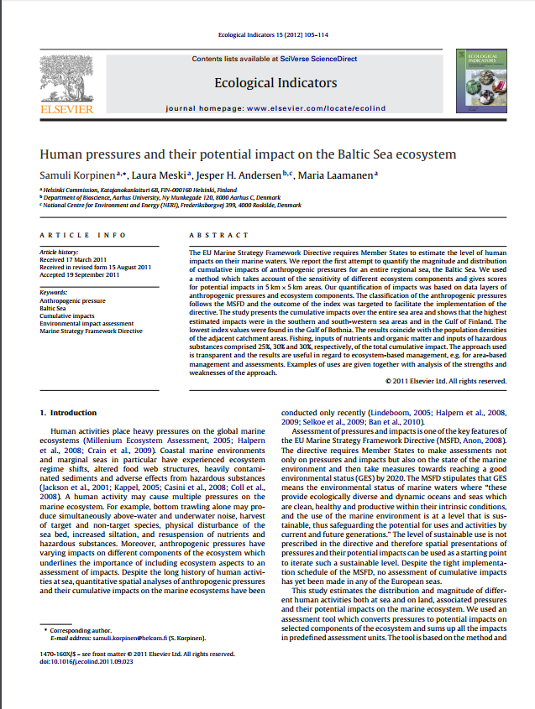
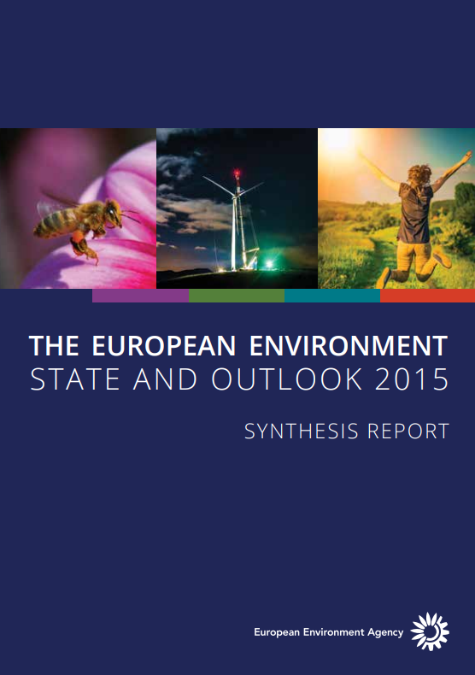
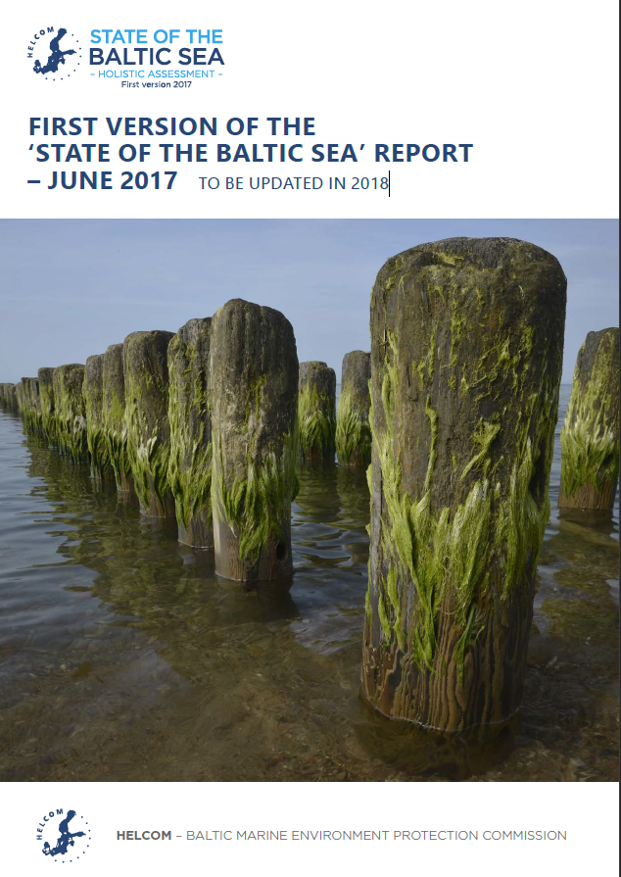
Round table on MSP “cumulative impact tools”
19 January 2018, Venice Thetis
Thank you for your attention!
Michael Assouline, PhD
Project Officer
Michael.assouline@eea.europa.eu

