Slide 1
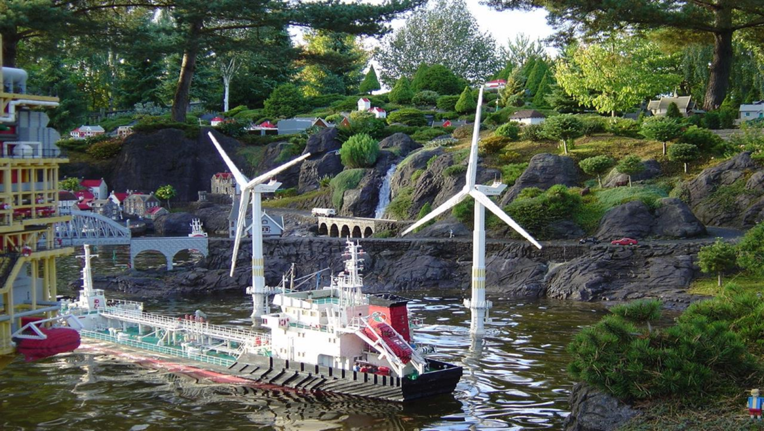
International cooperation between North Seas countries on
Marine Spatial Planning
&
Cumulative Effect Assessment
Rob Gerits

Slide 2
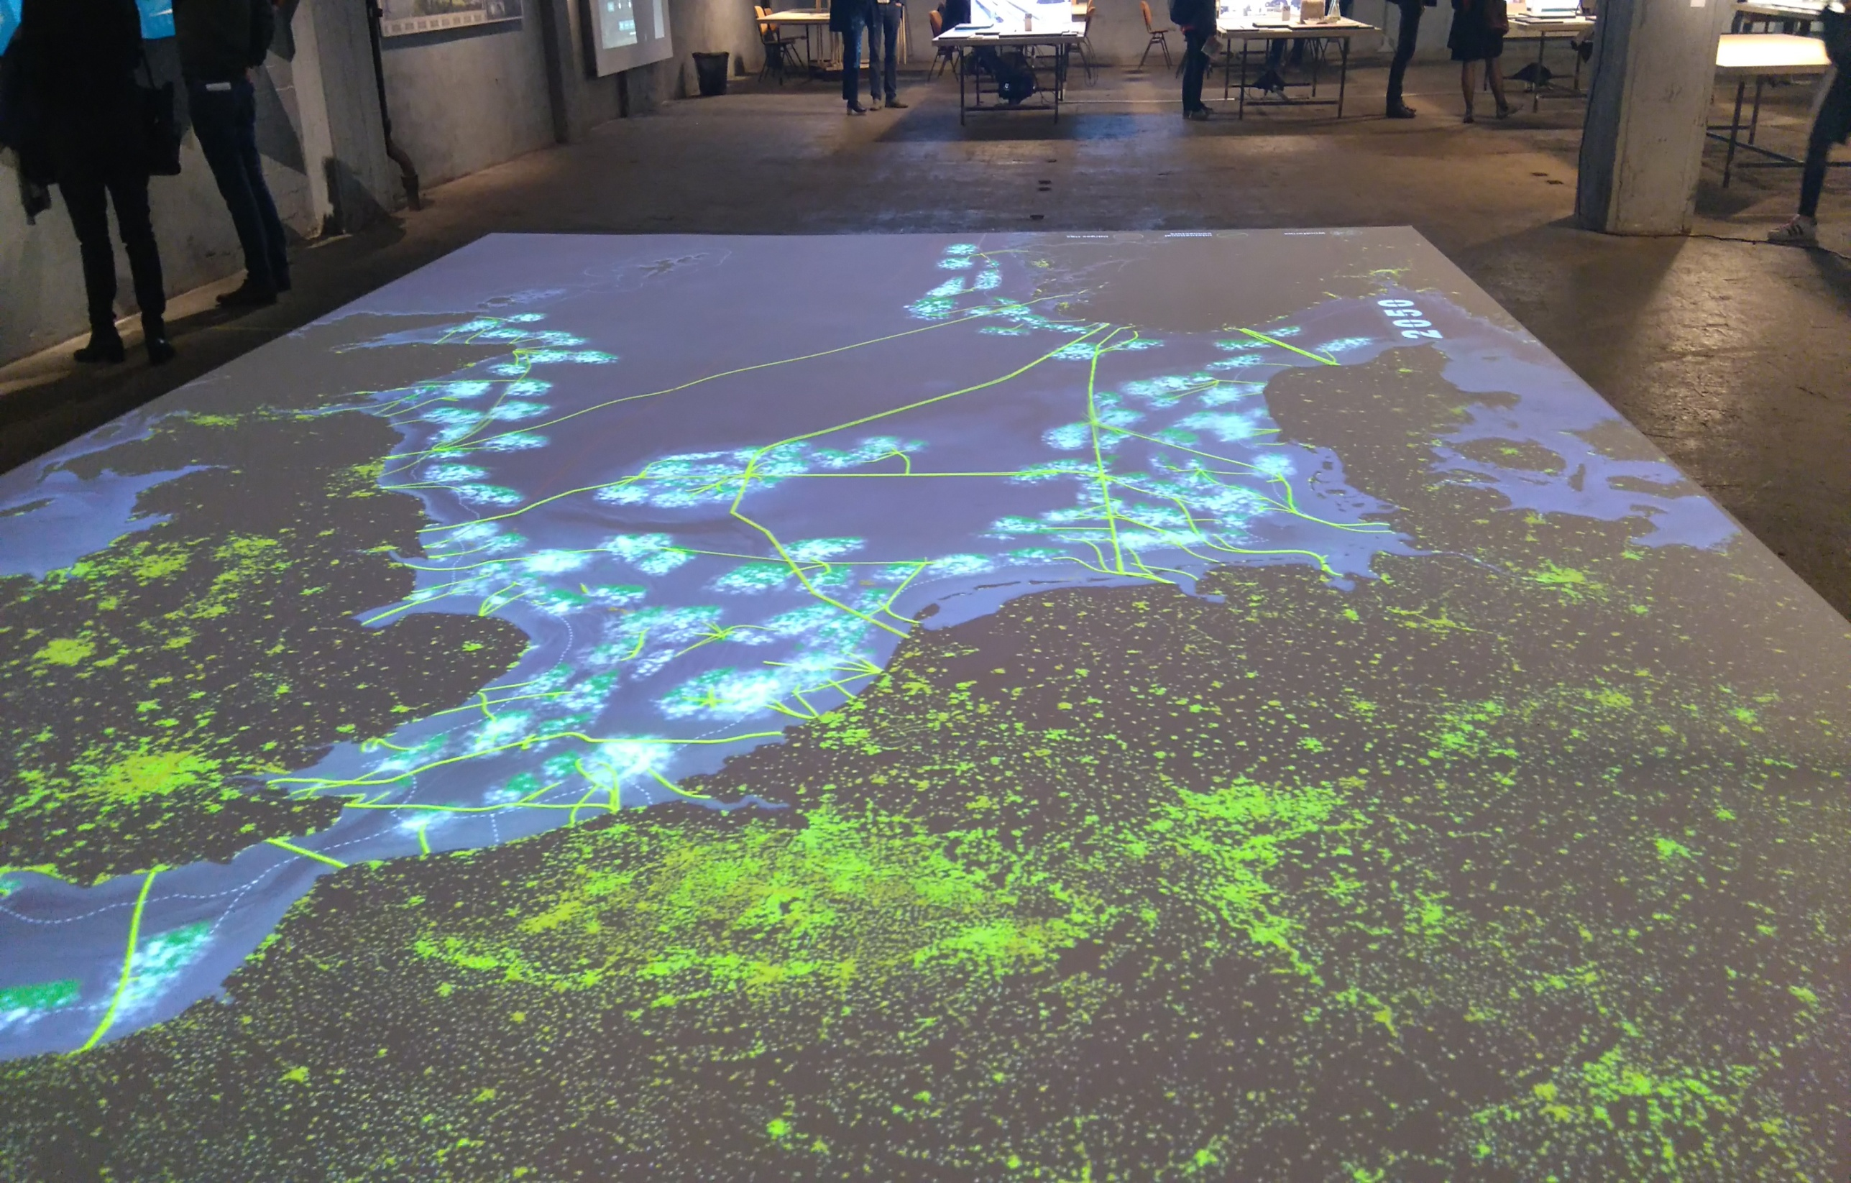
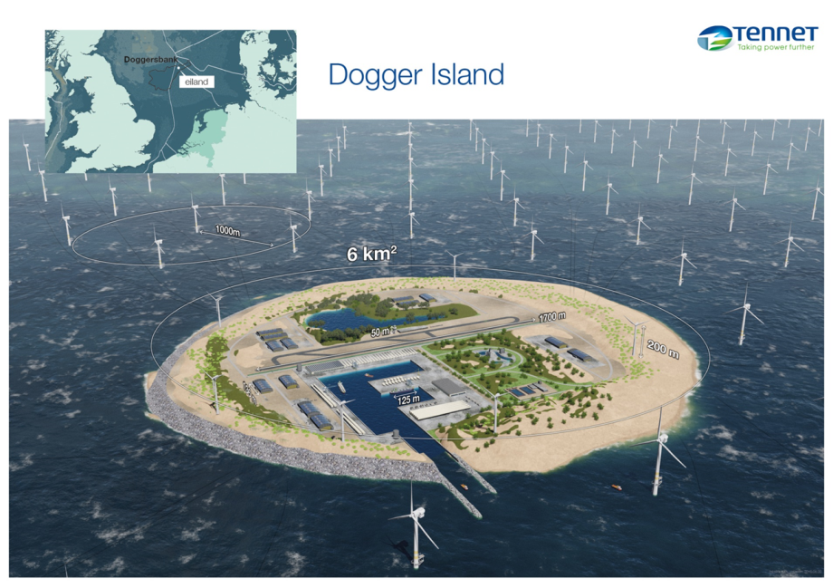
VISION IABR: NORTH SEA 2050?

Slide 3
Environmental risks of large scale offshore wind farm development
Wind farm development on this scale will most likely in cumulation have environmental impacts.
These cumulated impacts may hamper or even stop the desired development, because of unacceptable social and/or environmental impacts which may in addition go against national and/or EU legislation.

Slide 4
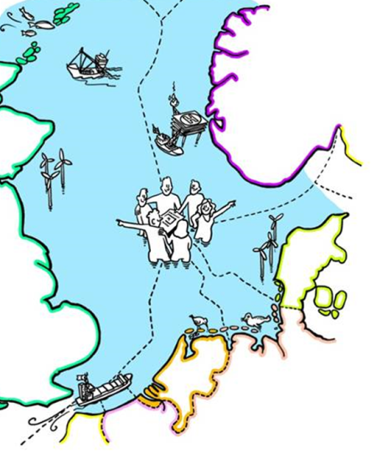
International collaboration
North Seas energy ministers want to facilitate the
development of offshore renewable energy by collaboration.
They* signed a Political Declaration in 2016 on a voluntary collaboration on 4 themes, including MSP and the environment.
International collaboration to prevent unacceptable environmental impact can:
clarify development opportunities for wind farms developers,
contribute to the conservation of species that are potentially affected by wind farm development.
contribute to cost efficiency for governments and developers,
stimulate technical innovations with regard to measures,
* Countries involved: UK, IRE, NO, SW, DK, GE, NL, BE, FR, LX and EC

Slide 5

An environmental subgroup* works on
A common approach for cumulative effect assessment (CEAF) of offshore renewable energy.
Important features:
A flexible approach (project-/strategic planning, ability to incorporating new knowledge and findings)
Relations with relevant international bodies (EU and OSPAR) and approaches within these bodies
A prototype ready in 2019, tested in 2018-19 in an EU-MSP project
* Countries involved: UK, IRE, NO, DK, GE, NL, BE, FR and EC

Slide 6
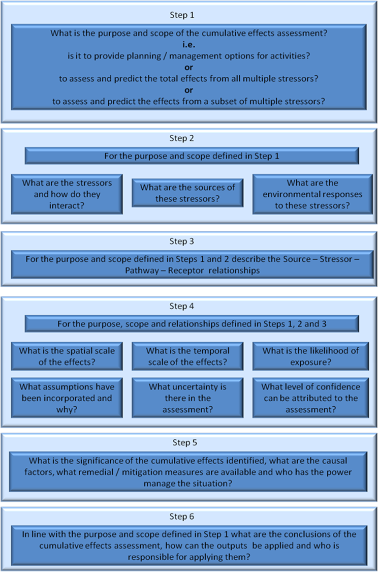
Common approach is a flexible, stepwise approach
Stepwise approach is developed by OSPAR for QSR
Can be used for other purposes
Based on a cumulative effect assessment per species/MSFD indicator
Flexible:
knowledge development and new models/methods for calculations can be incorporated
can include loops

Slide 7
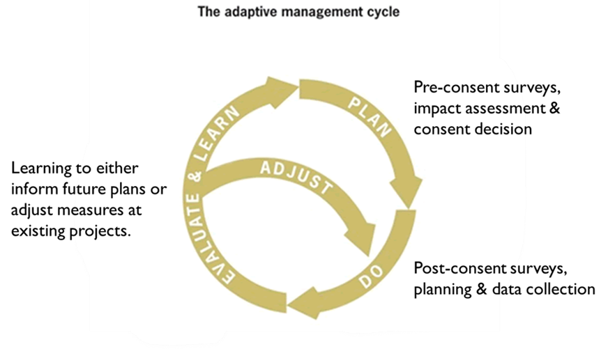
The common approach should fit in an Adaptive management process:
A cyclic process that includes a common environmental assessment framework (CEAF) and a common knowledge agenda (KA) on the knowledge gaps and science needs related to the framework.
CEAF
KA

Slide 8
Elements of the cumulative effect assessment
The spatial scale for effect calculation is the biological relevant region for the populations of the common species of concern.
Plans and projects in the biological relevant region are included that already have been completed, that are approved by the planning authorities, or that are currently undergoing planning approval.
Other activities that can affect a species of common concern are included if renewable energy development as a single activity is already likely to have strong adverse effects on this species.
Effect calculations/estimates are made by the most appropriate model(s)/method(s) for specific pressure-species relations.
Cooperation on approaches to determine acceptable levels of impact, attuned with OSPAR and EU work.

Slide 9
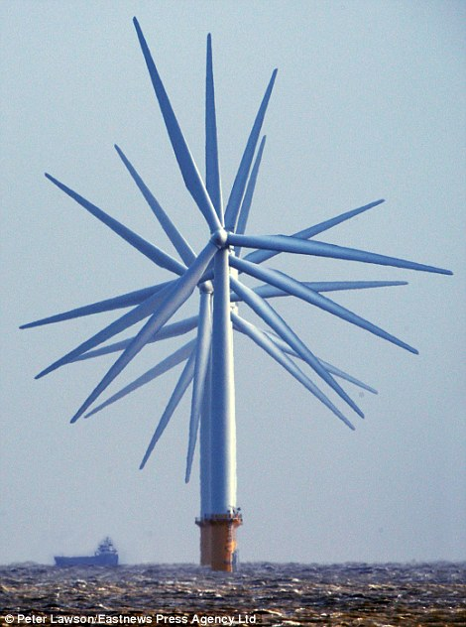
Thank you
Questions?
Useful link
https://ec.europa.eu/energy/en/topics/infrastructure/north-seas-energy-cooperation

