Slide 1
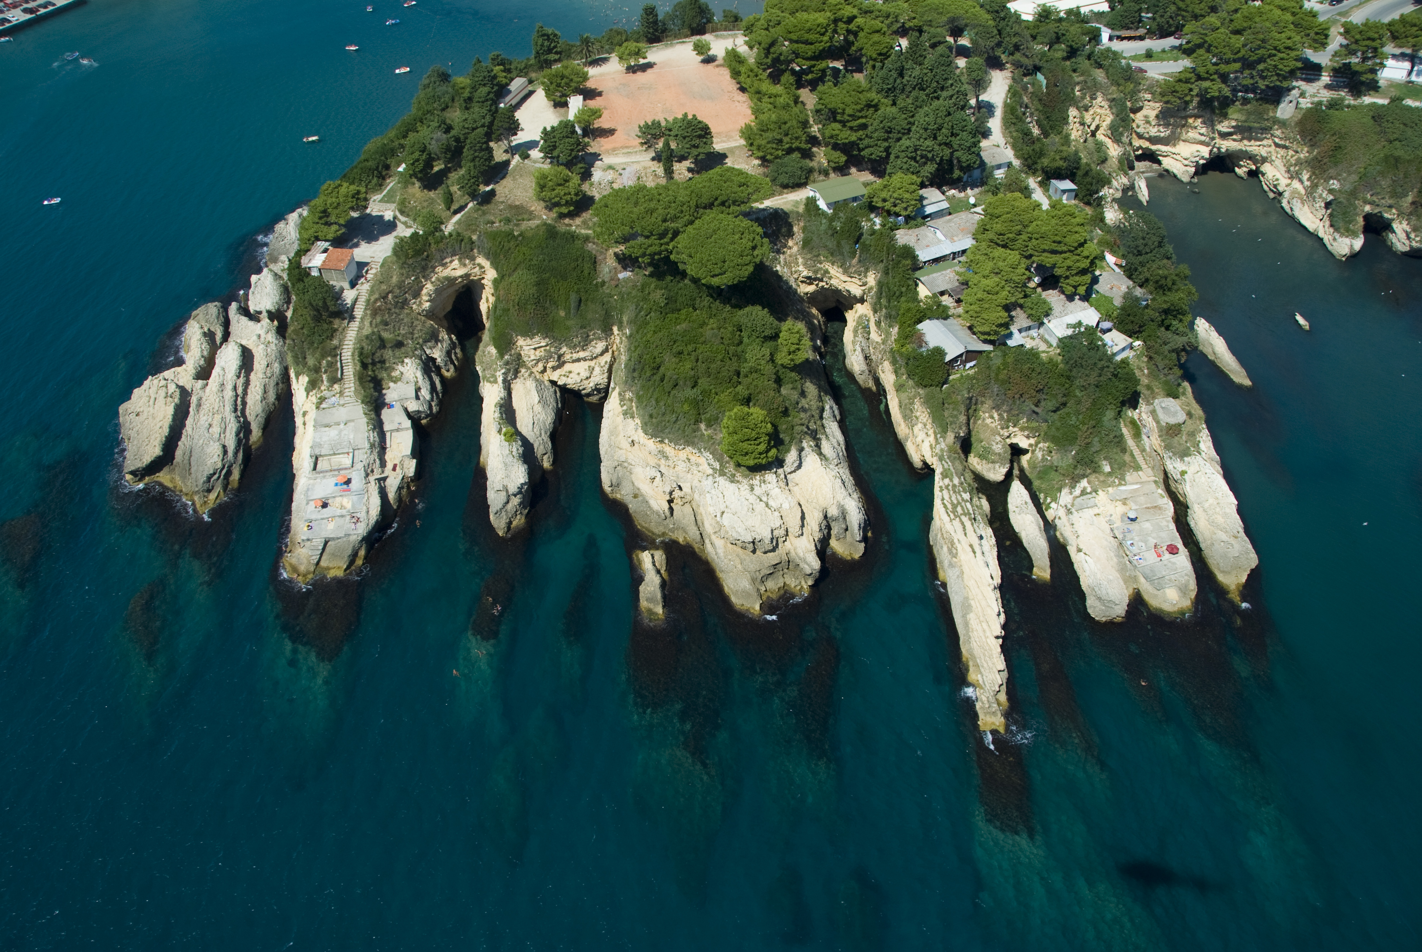



Using EcAp/IMAP indicators for MSP: Experience from Montenegro
Marina Marković/ 18.01.2018/ Venice
© PAP/RAC Photo/S. Vilus

Slide 2
The methodology
Integrated monitoring and assessment programme – EcAp ecological objectives (11 EO) and EcAp indicators
2

Slide 3
EcAp objectives and indicators
EO 1 Biodiveristy
Habitat distributional range/extent
Condition of habitat’s typical species and communities
Species distributional range (seabirds, mammals and reptiles, fish – EO3)
Population abundance
Population demographic characteristics
Biodiversity index
EO 8 Coastal ecosystems and landscapes
16. Lenght of coastline subject to phs. disturbance
Land use change
Landscape quality
EO 9 Contaminants
17. Concentration of key harmful contaminants
Level of pollution effects
Ocurrence…of acute pollution events
Level of contaminants in sea food
Percentage of intestinal enterococci
EO 3 Comercial species
7. Spawning stock biomass
8. Total landings
9. Fishing mortality
10. Fishing effort
11. Catch per unit of effort…
Bycatch of vulnerable and non-targeted species
Distribution of fish and shelfish farms
EO 2 Invasive Species
EO 10 Marine Litter
EO 11 Noise from Human Activity
EO 5 Eutrophication
13. Concentration of key nutrients in water column
Chlorophill-a concentration in water column
Trix index
EO 7 Hydrography
15. Location and extent of the habitats impacted…
3

Slide 4
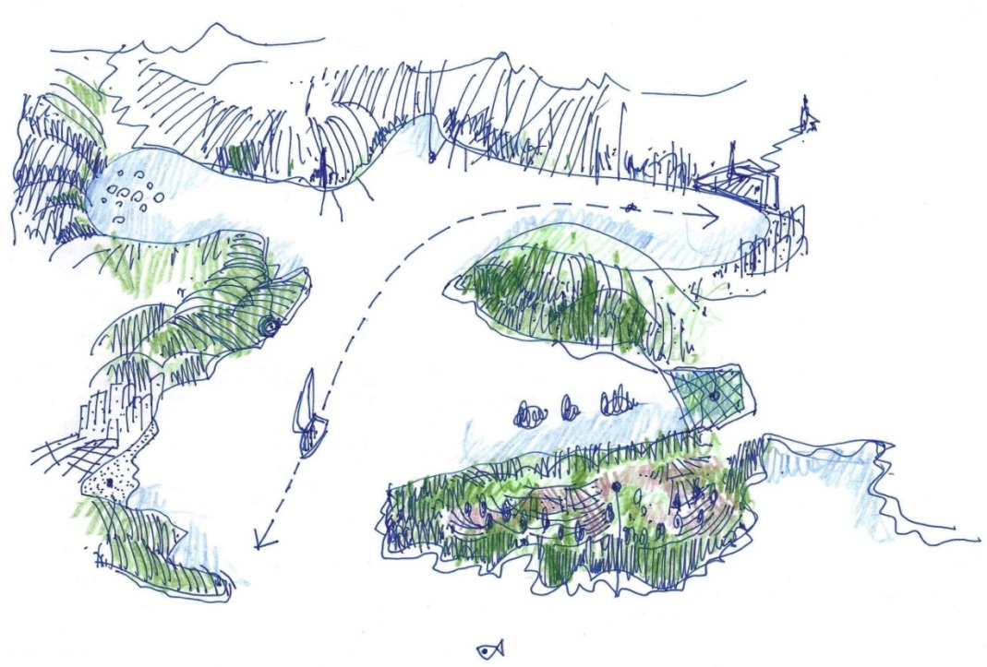
The methodology
Integrated monitoring and assessment programme – EcAp ecological objectives (11 EO) and EcAp indicators
Two main orientations:
Utilisation of EcAP for
marine vulnerability assessment
ii) Utilisation of marine vulnerab.
for MSP
Methodology tested in Montenegro
(Boka kotorska Bay)
4

Slide 5
















Methodology
5
Notes:
Identifies and assesses values; Identifies and assesses existing pressures – combining it is defines curernt state of impact on the environment

Slide 6

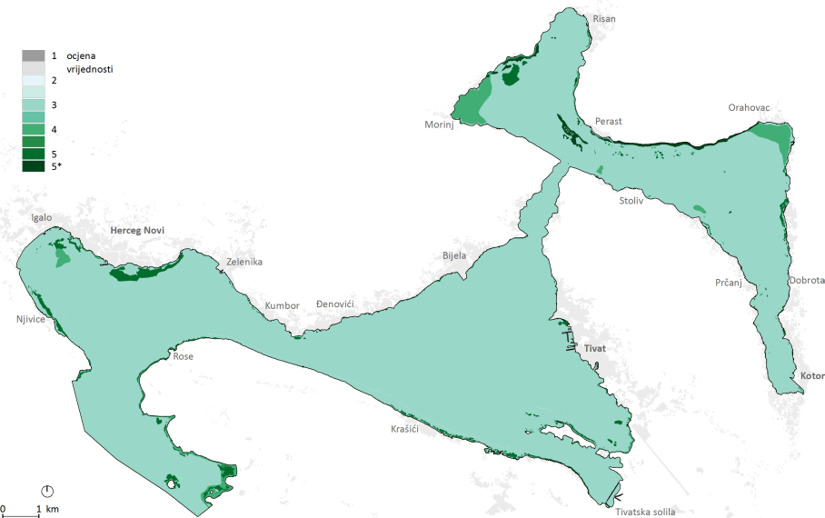
01 Assessing value of each env. component:
Habitats
Value: very low – very high (to extremely important)
Criteria: protection status, distribution/rareness, representativity,
6
Slide numbers to be added
as shown alongside

Slide 7

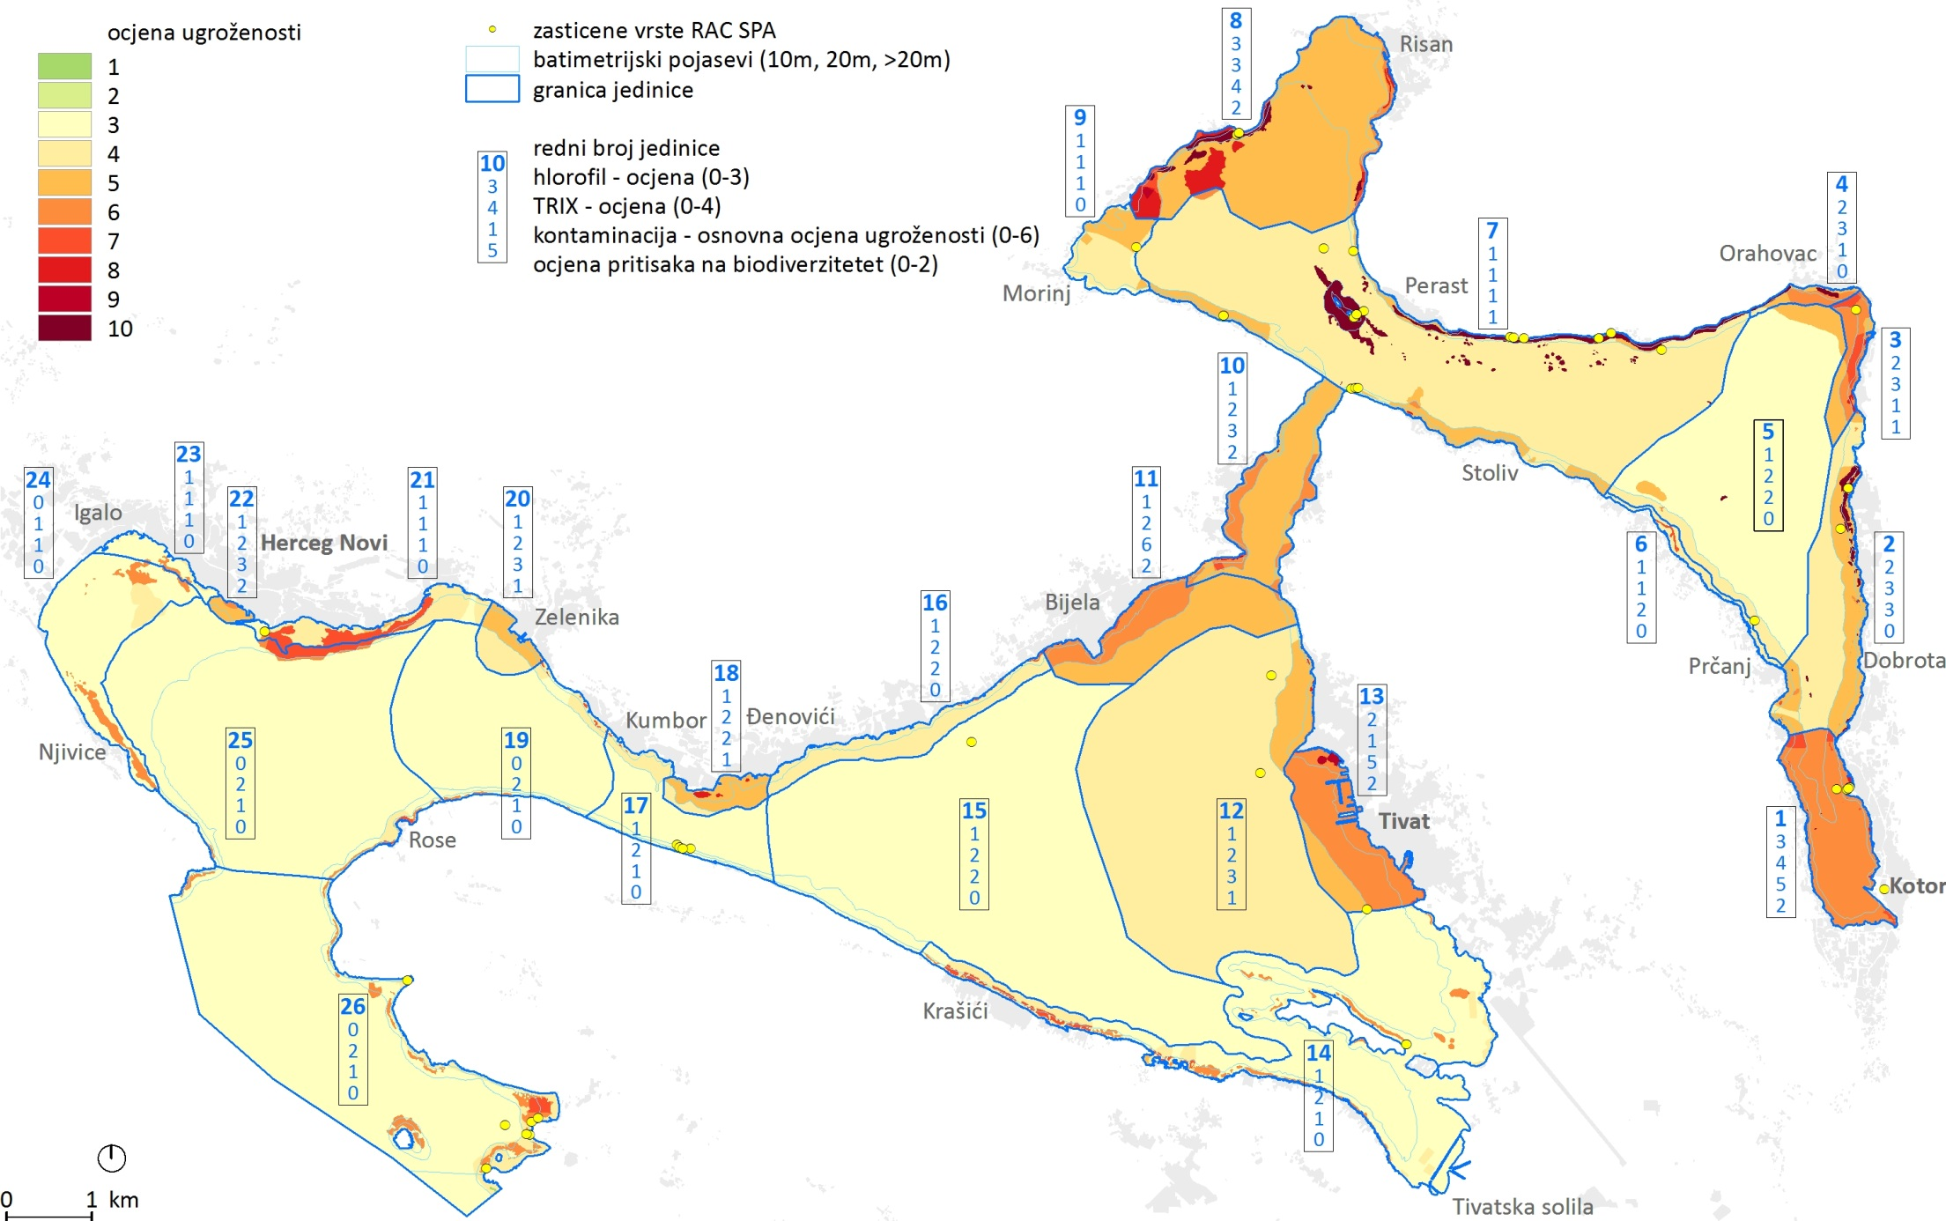

02 Assessing impact on each env. component:
Habitats
Existing Impact: very low – very high
Criteria: initial value index with impacts based on euthrophication (trix), contaminats, built-up areas, maritime way
7

Slide 8
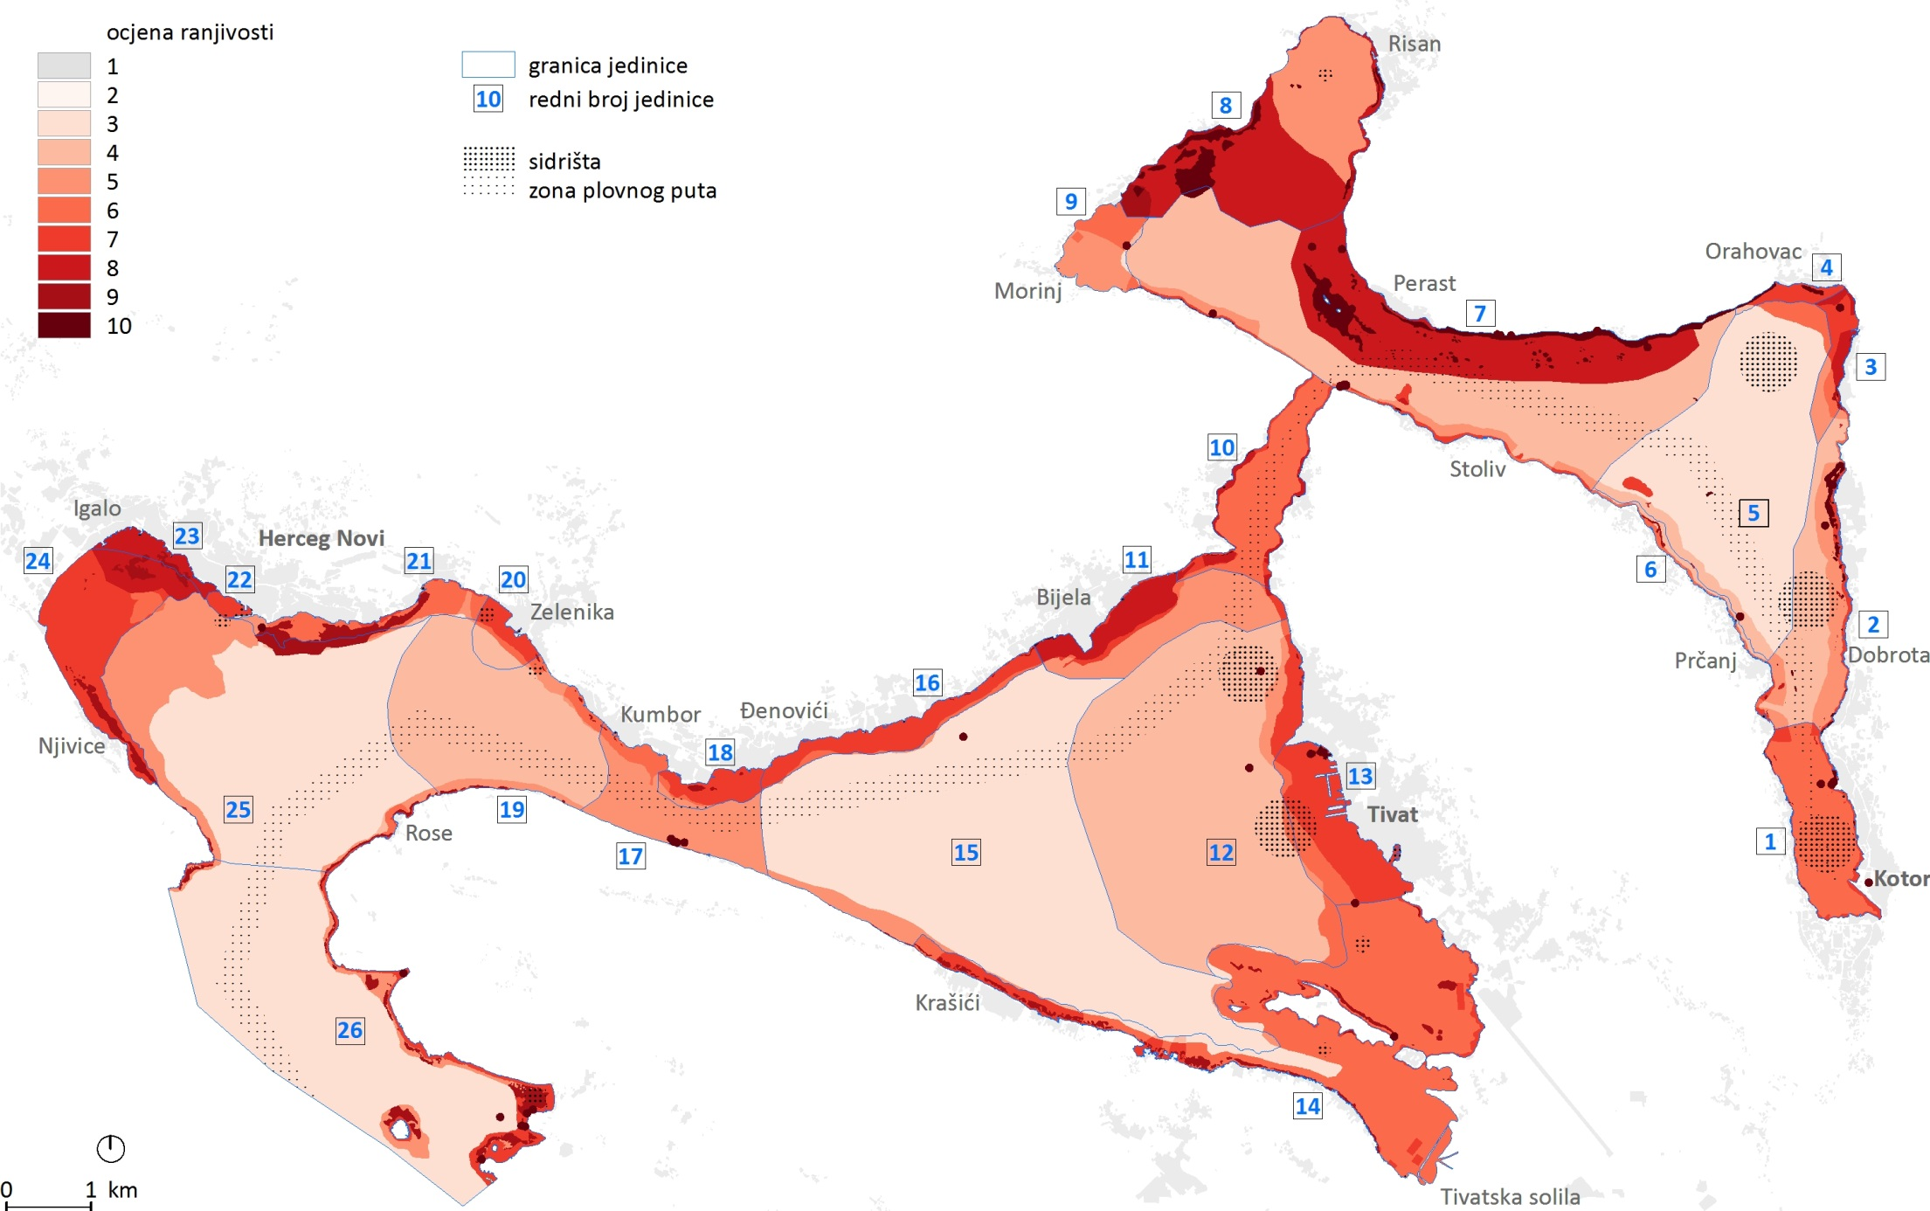
03 Assessing Vulnerability:
Habitats
Vulnerability to expected impact from activities (20): very low – very high
Each individual activity of each component of the environment
Criteria: extent of expected change, value/impact index, adaptive capacity
Vulnerability of BD to recreat. boating
8
Slide numbers to be added
as shown alongside

Slide 9
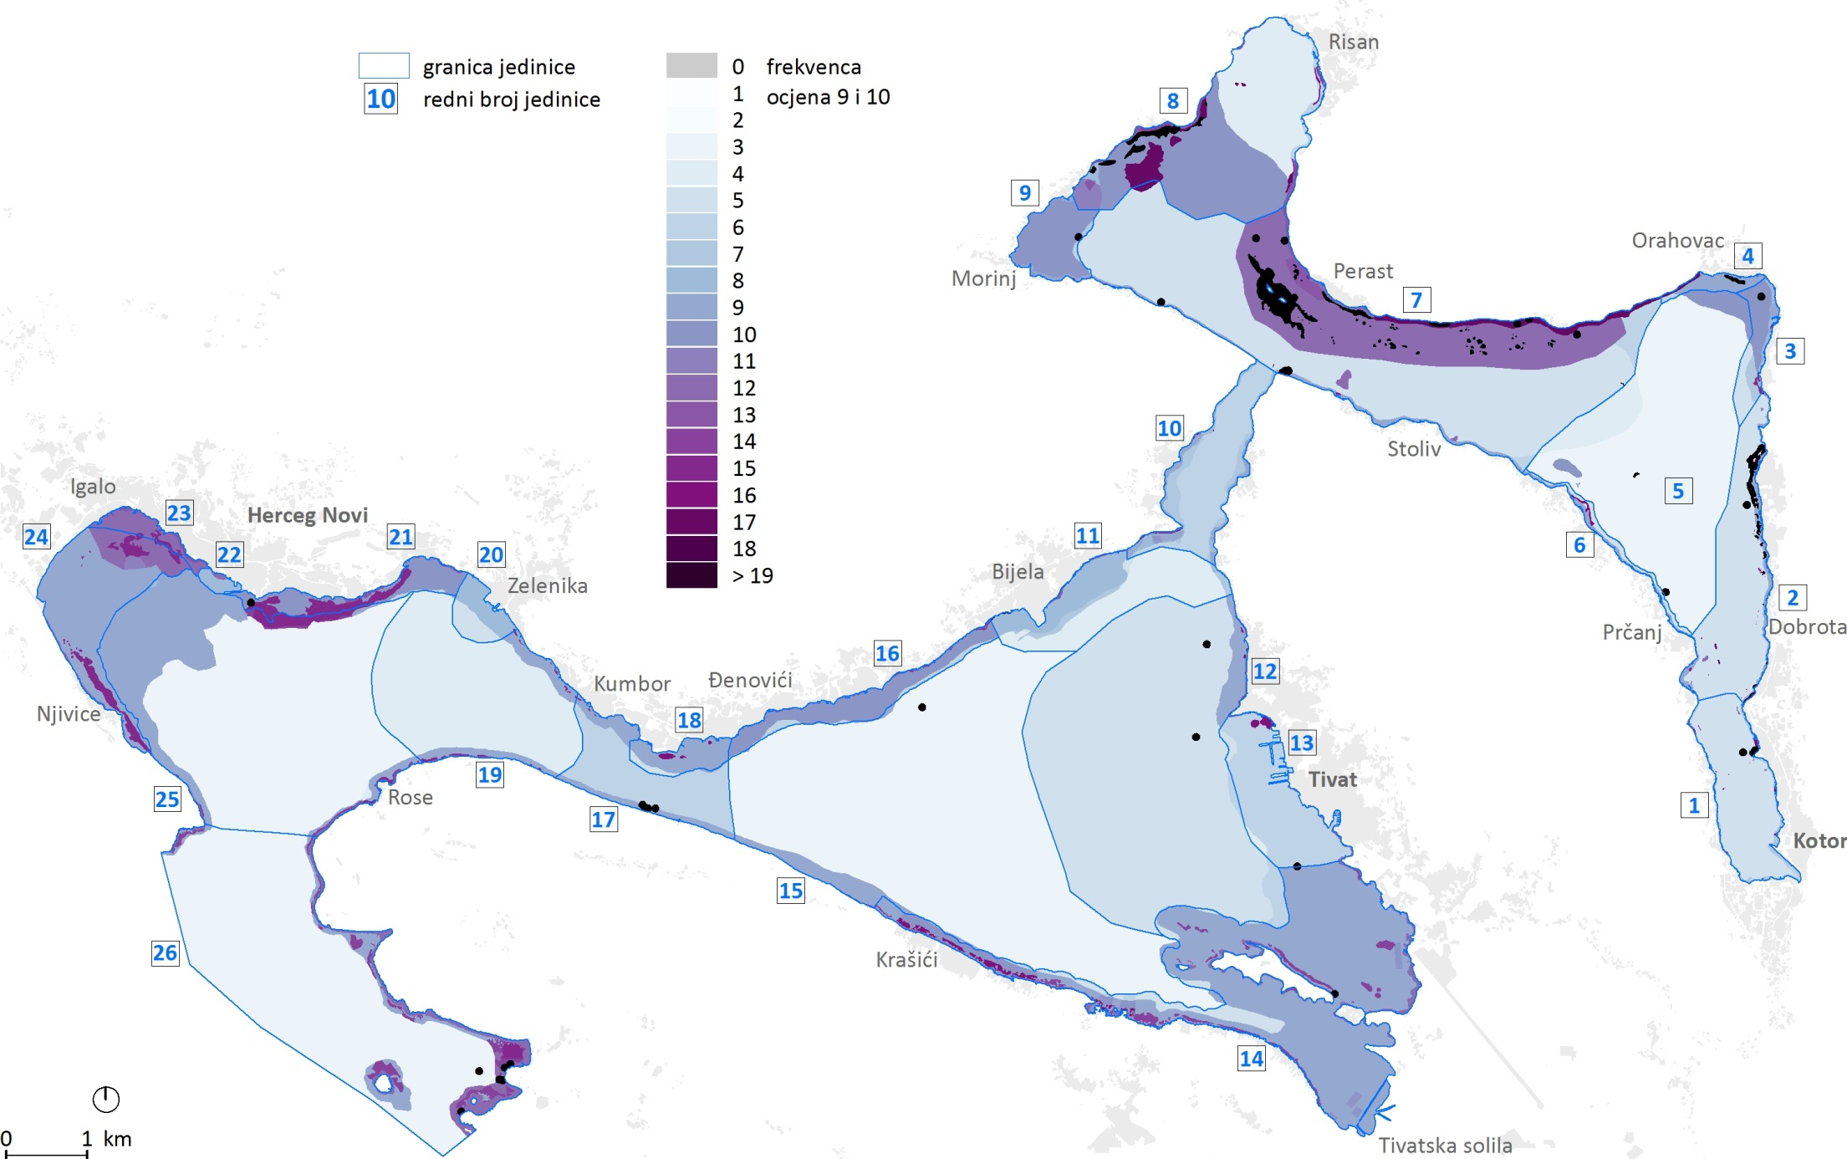
03 Assessing Vulnerability:
Integrated vulnerability of habitats
9
Slide numbers to be added
as shown alongside

Slide 10
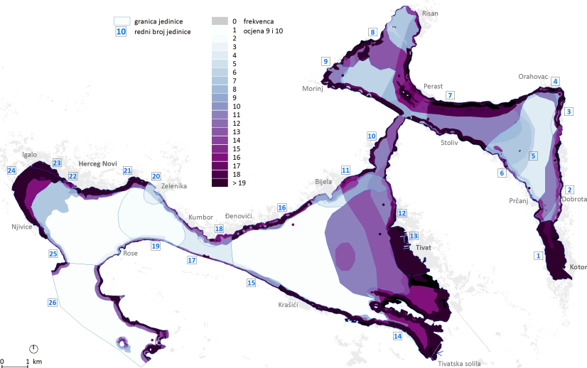
03 Assessing Vulnerability:
Integrated vulnerability of all environmental
components and activities
10

Slide 11
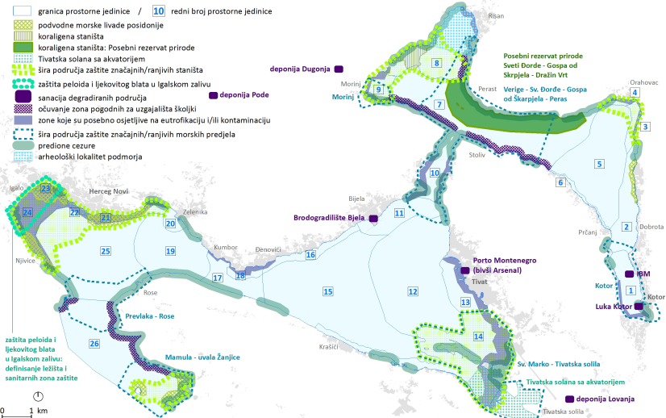
The tool CAN:
Planning (env.) recommendations
11

Slide 12
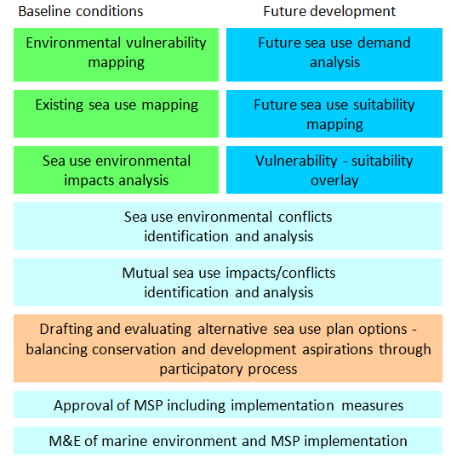
The tool CAN
12
Notes:
Imperative reasons for overriding public interest

Slide 13
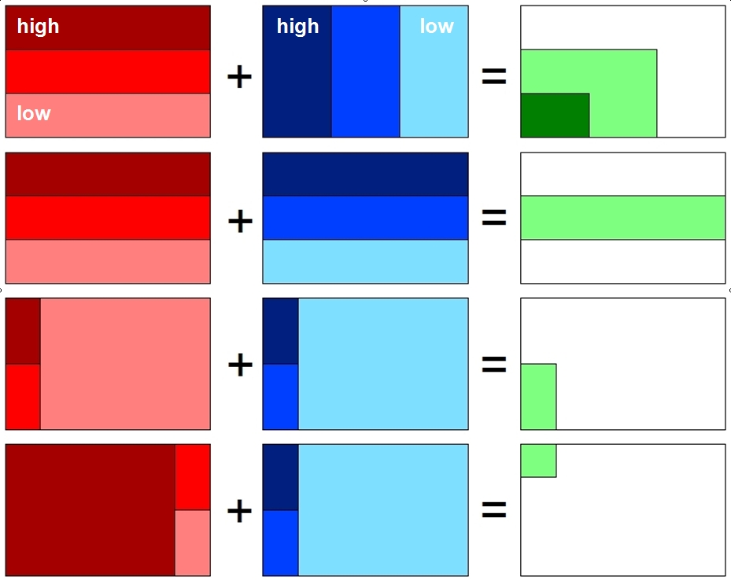
The tool CAN
environmental vulnerability | sea use suitability | sea use options
optimum
compromise1
compromise2
IROPI?
13

Slide 14
The tool CANNOT
environmental vulnerability | sea use suitability | sea use options
optimum
compromise1
compromise2
IROPI?
14

Slide 15

Limitations and future
Not all indicators fully suitable/necessary for VA – review the list
Complex
Expert opinion
Further testing and upgrading the tool
SUPREME – important component related to the development of a tool for assessing cumulative impacts related to marine
15
Slide numbers to be added
as shown alongside

Slide 16


Thank you
..
www.paprac.org

