Slide 1

Symphony
a cumulative assessment tool in Swedish Marine Spatial Planning
Jan Schmidtbauer Crona, SwAM
Duncan Hume Swedish, Geological Survey SGU
Linus Hammar, SwAM project leader
Symphony (Zara Larsson)
I've been hearing symphonies
Before all I heard was silence
A rhapsody for you and me
And every melody is timeless
Life was stringing me along
Then you came and you cut me loose
Was solo singing on my own
Now I can't find the key without you
Chorus:
I just wanna be part of your Symphony
Will you use it wisely and not let go?
Symphony
Like a cumulative assessment tool on the
MSP show Will you use it wisely and not let go?

Slide 2
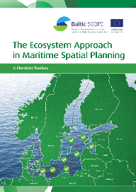

1. What are the challenges the tool seeks to address?
Implement the Ecosystem Approach
Integrate environmental considerations in planning
Carry out great Strategic Environmental Assessments
Link between MSP and MSFD
Good organized spatial data on ecosystem and pressures

Slide 3
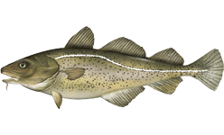
A chain of links
Cumulative impact on all (j…n)
Pressure 1
Effect (1,j)
Ecological component, j
Cumulative effect on j
Effect (2,j)
Pressure 2
Effect (3,j)
Pressure 3

Slide 4
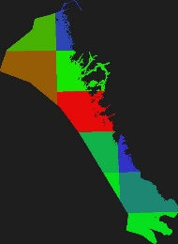
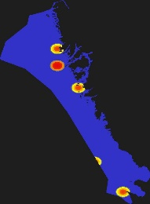
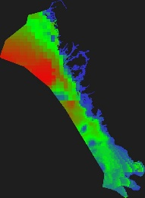
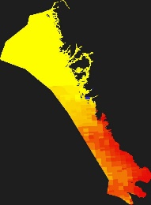
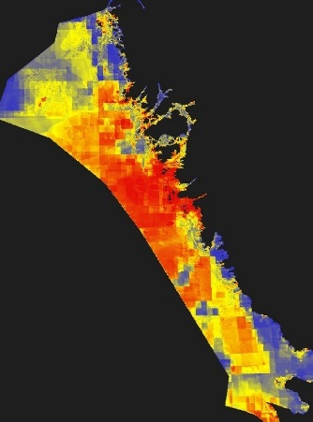
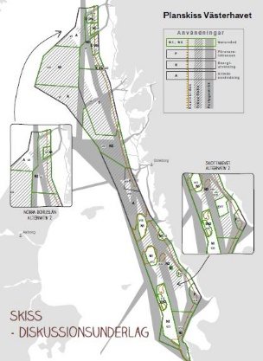
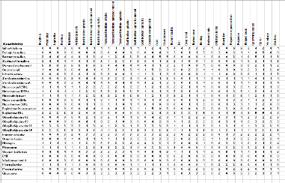
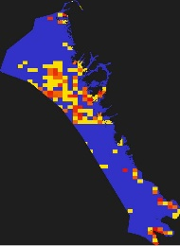
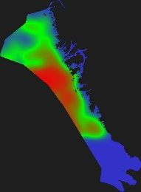
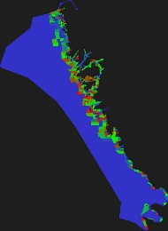
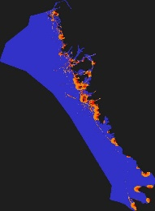
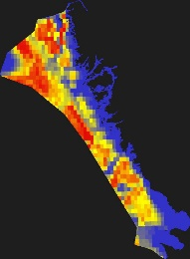
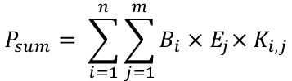
Symphony method
Transparent and science-based
Ecosystem components (35)
Human pressures (44)
Sensitivity matrix
Baseline results
MSP results
$$P_{sum}= \sum_{i=1}^{n}{\sum_{j=1}^{m}{B_{i}}{×E}_{j}×K_{i,j}}$$
Cumulative impact (P) is calculated as the sum of the product of all pressures’ (B) effect on all ecosystem components (E), given the particular sensitivity (K) of every ecosystem component to every pressure.
More sustainable plans

Slide 5
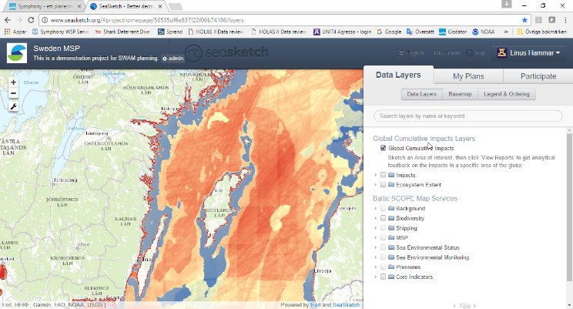
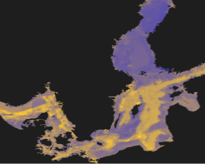
Symphony development
Symphony application
Halpern method
(Science 2008)
Software application where pressures can be easily adjusted and alternative plans tested
All based on existing data
All data, metadata and results will be made public
Total budget € 300 000

Slide 6
2. What can Ecoimpactmapper do?
Open source java tool (created by Andy Stock).
Baseline maps of total cumulative impact (CI),
Maps & statistics: % contribution of each pressure to total CI and % of the CI impact on each ecosystem component
Uncertainty modelling
Data viewing – desktop application.

Slide 7
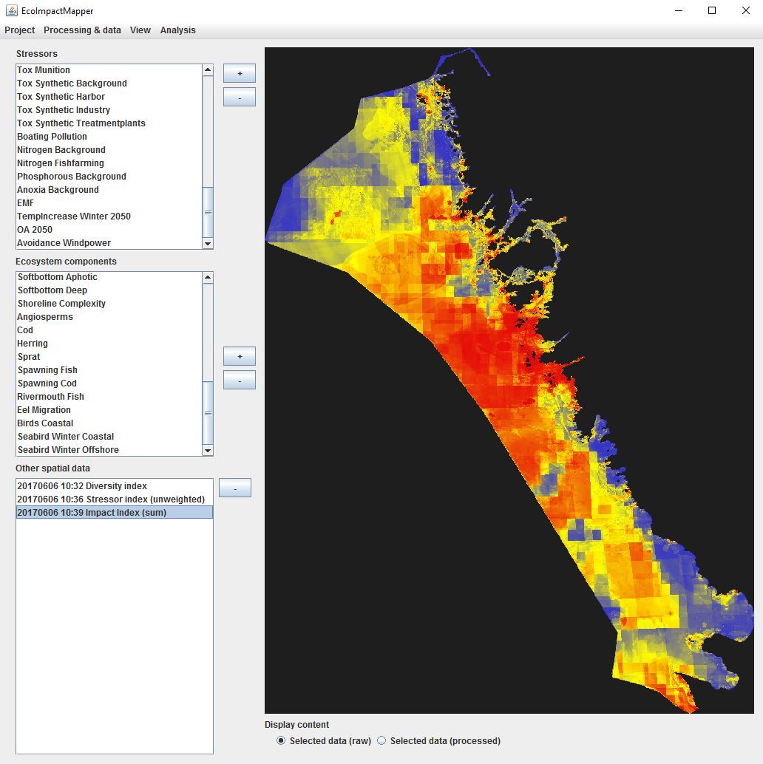
Cumulative impact on Swedish west coast
Low
High
Very high
Sector | Contribution
Climate change (2050) | 23.3%
Fisheries | 22.3%
Eutrophication | 22.2%
General pollution | 15.7%
Shipping | 12.3%
Coastal activities | 2.1%
Defence | 0.8%
Industry | 0.8%
Energy | 0.4%
Aquaculture | 0.0%
Mineral mining | 0.0%

Slide 8
2. What can Ecoimpactmapper not do?
Facilitate management / publishing of data & metadata
Operate with shapefiles or raster data
Operate over a network or with multiple users
Model pressures directly from activity data
Standardise input data layers
Calculate the impact of future plan scenarios

Slide 9
2. What can Symphony enhanced SeaSketch do?
Seasketch software (developed at University of Santa Barbara)
Baseline maps of total cumulative impact (CI)
Statistics: % contribution of each pressure to total CI and % of the CI impact on each ecosystem component
Spatial scenario modelling - predicted CI increase or decrease as a result of spatial planning policies.
Scenario output maps and statistics.
Data viewing (webmap) & interactive forum

Slide 10
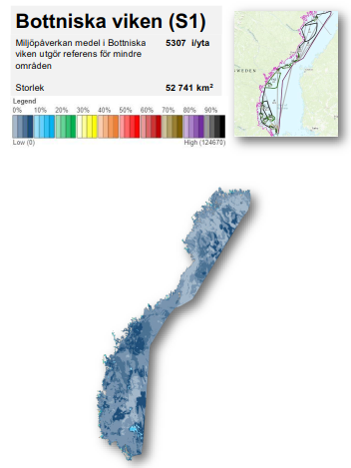
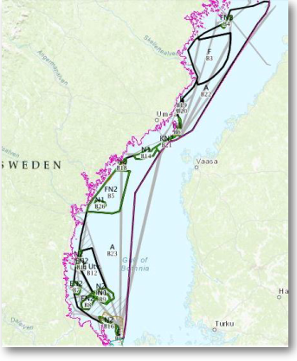

Slide 11
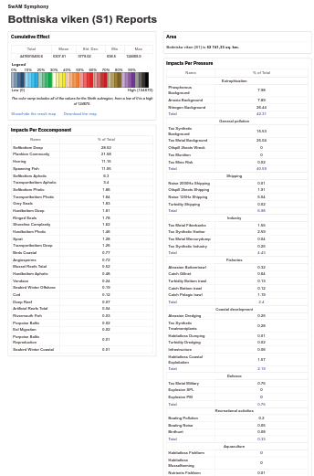
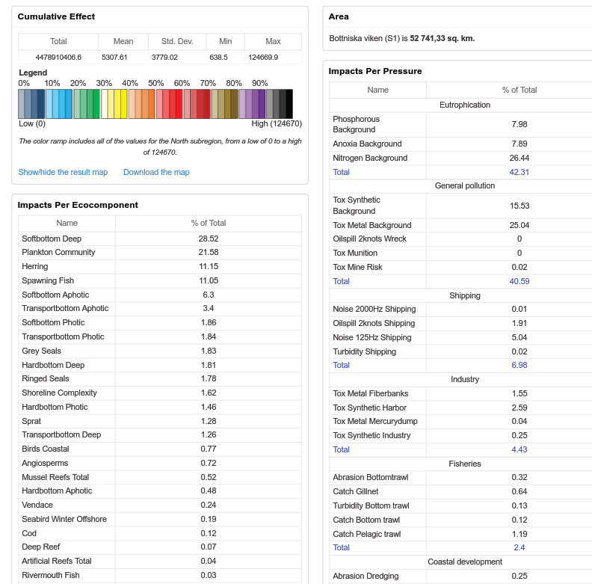

Slide 12
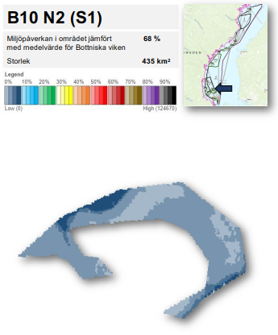
Assessment of impacts of all draft plan polygons- basis for redevelopment of draft to consultation version o

Slide 13
2. What can Seasketch not do?
Management & sharing of data & metadata
Standardise / QA input data layers
Model pressures directly from activity data
Model ecosystem components from observational data
Accurately calculate the CI for future plan scenarios
Calculate CI model uncertainty
Calculate model sensitivity to input data quality

Slide 14
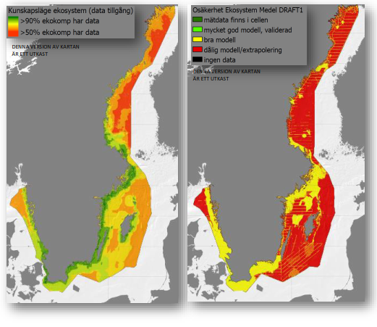
Trustworthy data?
Green > 90 % data available for
ecosystem components
Red > 50% data aviailable for
ecosystem components
Dark green = based on empirical data
Green = very good model
Yellow = good model
Red = bad model
Black = no datay
Data availability
Data uncertainty

Slide 15
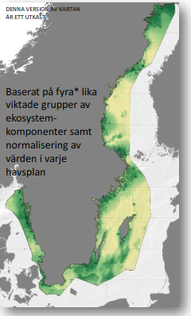
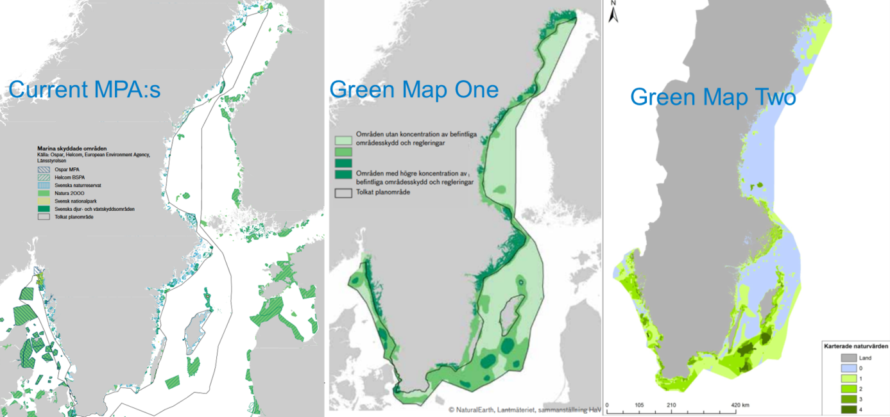
Continuous data improvement
Green Map Three
Data quality improvement might change impact scores.
Is this a problem for monitoring CI change over time?

Slide 16
3. What COULD it do in the future?
Links between the tool and archive / monitoring databases
Encorperate local knowledge and values (participatory GIS)
Model pressures & uncertainty from activity data (automation)
Develop more sophisticated predictors (e.g. displacement)

Slide 17
3. What COULD it do in the future?
Use activity-pressure models for plan scenario CI calculation
Include the socio-economic dimension (ecosystem services)
Predict if GES (for MSFD) is reached with plan scenarios
Optimised for application at different management scales (e.g. transbounday or local)

Slide 18
4. What are the limitations for developing the tool?
Ecoimpact mapper is an ”as is” desktop based freeware which uses csv files as indata
SeaSketch is a user friendly commerically licensed tool - only part of source code is open (Ben Halpern’s Lab).
Swedish ”limitations”: EU-law: data use and procurement regulations, future development should be ’open’, & ease of use is essential (planners are the end users)

Slide 19
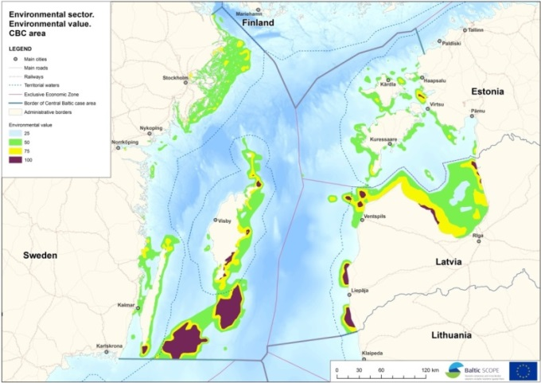
Future development
Helcom/Vasab- MSP working group and the new EU-project PanBaltic SCOPE 2018-2019
Further implementation of the ecosystem approach in MSP
Shared Baltic view on marine green infrastructure/blue corridors
Application of cumulative assessment tool Symphony on Baltic data from Helcom Holas II
Challenges: Linking MSP with MSFD-GES
Application SEA in a crossborder context

Slide 20
Any questions?
Climate change temperature
Marine mining turbidity
Marine mining habitat loss
Boating pollution
Shipping oil spill
Boating noise
Ocean acidification
Marine infrastructure
Shipping turbidity
Toxic munition
Nitrogen aquaculture
Plankton
Harbor pollution
Spawning ground
Habitatloss aquaculture
Industry pollution
Mussel reef
Wreck oil leak
Birdhunt
Habitatloss coastal exploitation
Coral reef
Soft bottom
Deep reef
Hard bottom
Sprat
Abrasion dredging
Turbidity dredging
Cod
Seagrass
Pollution military
Habitatloss dumping
Shipping noise
Eel
Herring
Explosions military
Noise wind power
Transport bottom
Porpoise
Electric field cables
Seabird wintering ground
Runoff nitrogen
Grey seal
Runoff phosphorous
Rivermouth
Artificial reef
Anoxia
Trawl fishing turbidity
Net fishing catch
Harbour seal
Seabirds
Pelagic fishing catch
Trawl fishing catch
Trawl fishing abrasion
Notes:
Implement the Ecosystem Approach
Integrate environmental considerations in planning
Carry out great Strategic Environmental Assessments
Link between MSP and MSFD
Good organized spatial data on ecosystem and pressures

